Slide 1
NPDB Reporting – Time for a change?
Kathy Matzka, CPMSM, CPCS, LLC
www.kathymatzka.com
kathymatzka@kathymatzka.com

Slide 2
Issues
The Act requires reporting of adverse professional review actions taken against “physicians” MD, DO, DDS, DMS
“Permissive reporting” on other licensed health care practitioners if the entity would be required to report such information if the practitioner were a physician
Reporting of a professional review action that adversely affects the clinical privileges of a physician for a period longer than 30 days

Slide 3
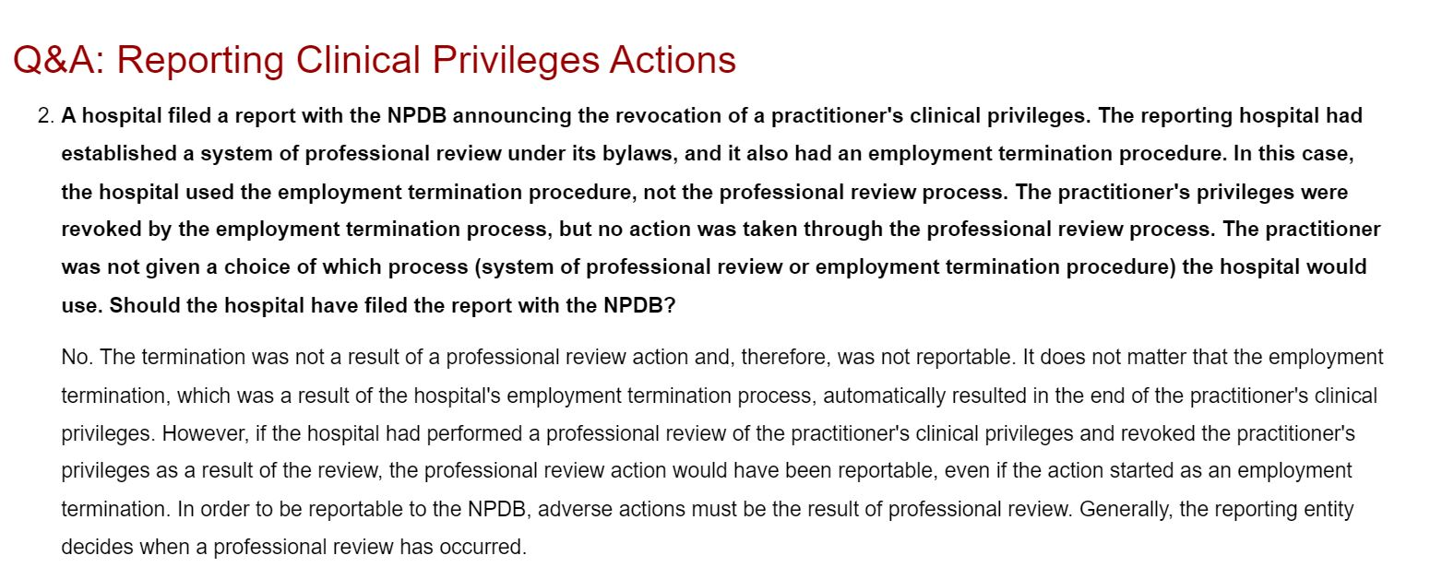

Slide 4
Issues
Hospitals settling doctors out of lawsuits, so no NPBP medical malpractice report (corporate shield)
Hospitals contracts with physician employees include “clean sweep provision” - employed physician agrees to waive all fair hearing and appeals rights in lieu of hospital’s employment termination grievance process – so no NPDB report

Slide 5
Discussion Issues

Slide 6
Discussion
Med mal reports to NPDB in the name of a health care practitioner on whose behalf the malpractice payment is made - regardless of whether or not the practitioner is named as a defendant in the claim or whether or not the hospital settles them out of the claim

Slide 7
Discussion
Report professional review action for anyone who has medical staff appointment and/or clinical privileges – not just those meeting the current definition of “physician”

Slide 8
Discussion
Report professional review action regardless of length of action – not just over 30 days

Slide 9
Discussion
Giving all employed practitioners who have adverse privileging actions the option for medical staff hearing, regardless of contract, with option of having impartial outsiders on hearing panel in the case of hospital with all employed physicians

Slide 10
Discussion
If peers are hospital employees, is there a problem with “good faith” peer review? Will doctors be afraid to go against the employer?

Slide 11
Discussion
What does it take to get HCQIA changed?

Slide 12
Discussion
If revisions are posted for review, will it open the door to other recommended changes that may not be ideal, such as opening the NPDB to the public?

Slide 13
Discussion
What about expanding of NPDB to include a credentialing data base that healthcare organizations can utilize?

Slide 14
Discussion - Penalties for not Reporting
Current: “If a request for a hearing is denied or if HHS determines that a health care entity has substantially failed to report information in accordance with NPDB requirements, the name of the entity will be published in the Federal Register, and the entity will lose the immunity provisions of Title IV with respect to professional review activities for a period of 3 years, commencing 30 days from the date of publication in the Federal Register.”
Questions:
How many entities been subject to penalties?
What is “substantial” non-compliance?
Would increasing penalties do any good?

Slide 15
Other Discussion?

